Slide 1
Oliver Wyman Impact
Mainland China
Case Competition 2022
March 2022

Slide 3
1
The Case

Slide 4

Welcome to 2022 Oliver Wyman Impact Mainland China case competition!
Confidential
Case background
Our client is an emerging auto manufacturer in China, focusing on entry-level passenger vehicles targeting young customers. Though in start with their business, they are facing intense pressure from both local and global competitors.
However, our client is now struggling with limited knowledge on market and major competitors’ business models. Besides, they would like to understand whether they are able to capture the opportunities in such complex and dynamic market in China, as well as which go-to-market model they should take.
Your team is invited by the Chief Strategy Officer of the client to provide your advice and perspectives on this topic.

Slide 5
CASE QUESTIONs
Confidential
To help your client understand market dynamic and develop business strategy, please answer below questions:
1
Market overview
What are the main business models (e.g. dealership, direct sales and vendor model) and future trend for OEMs in China and globally?
What are the pros and cons for different business models?
2
Customer analysis and company positioning
What are the main features for entry-level passenger vehicle customers, especially the young customers? Please describe the customer profiles in a brief and clear way.
Considering its own strengths and weaknesses, how should our client position itself?
3
business strategy
Given the market overview and company situation, our client wants to know their go-to-market model. What are your suggestions and why?
What kind of brand strategy should our client develop and why?

Slide 6
2
Info and TIPs

Slide 7
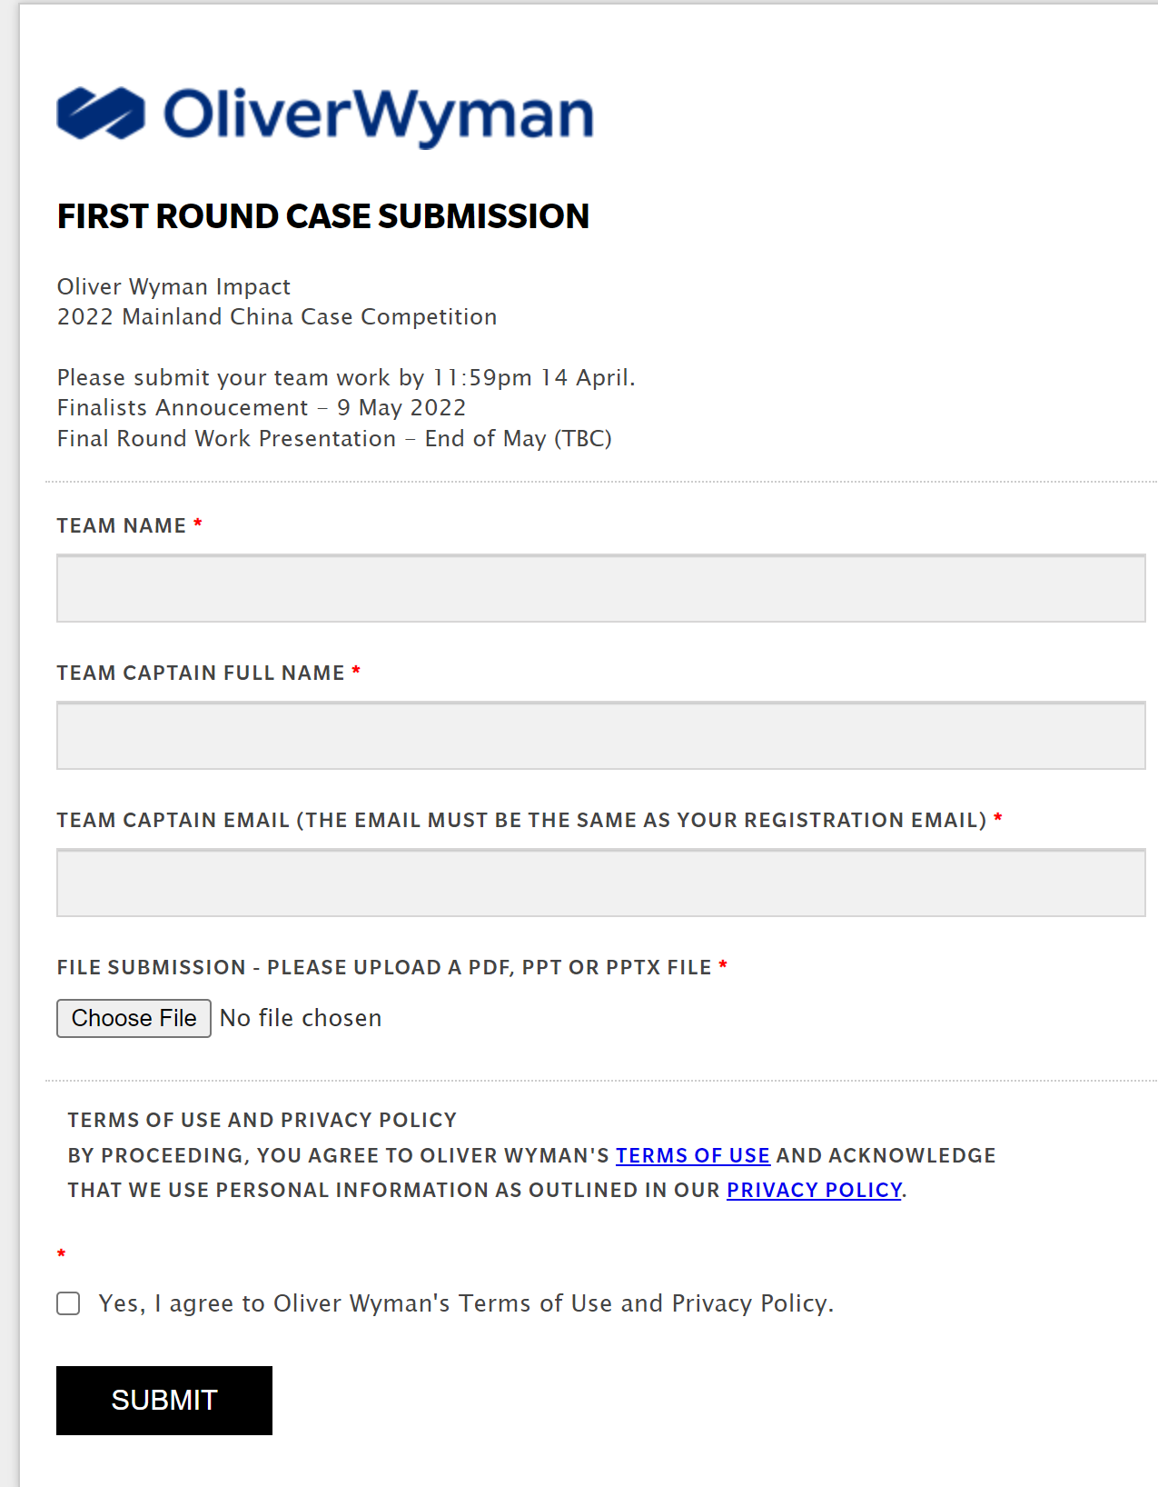

FOR THE 1ST ROUND SUBMISSION…
Confidential
When and how to submit it?
Please submit your document by 11:59pm, April 17th, 2022¹ via our case submission portal: https://oliverwymangroup.wufoo.com/forms/p38d9zl0tcnp17/
1. Beijing Time Zone; Late submissions will not be accepted
2. Only one submission is required for each team.

Slide 8

SOME TIPS FOR YOUR DOCUMENT…
Confidential
Length
Additional Tips
To make sure your recommendations are clearly delivered, kindly control the main document within 20 content slides.
(i.e. not including agenda pages or additional data analysis in appendix).
Layout: 4:3 slide scale is recommended
Language: English is preferred throughout the entire document
About fonts, some easy ways to make your document look professional:
Using Calibri font
Minimum 20 font size for title, 14 font size for slide taglines, 12 font size for main body text
Format: .pdf, .ppt,.pptx are all accepted, but .pdf is highly recommended

Slide 9
What should I expect after the slide submission?
Confidential
To the Final Round…
How will my slides be judged?
All submissions will be reviewed carefully by Oliver Wyman and top teams will be invited to a final presentation
The invitation to the Final Round will be released in early May
The Final Round Presentation will take place around end of May
Judges will evaluate submitted documents based on such factors as the breadth and depth of analysis, relevance, originality, persuasiveness and overall presentation
A panel of judges will evaluate your document mainly based on the following criteria:
Accurate and deep fact-based analysis
Clear logic in developing recommendation
Impactful business recommendation
Reader-friendly document
1. Teams invited to the final round will be notified on further details.

Slide 10
Last but not the least…
Confidential
Good Luck!
See you at the Final Round

